Slide 1
Stereolithography (SLA).
Acronyms; Optical fabrication, Resin printing, photo solidification.

Slide 2
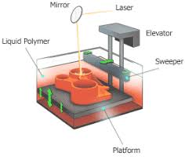
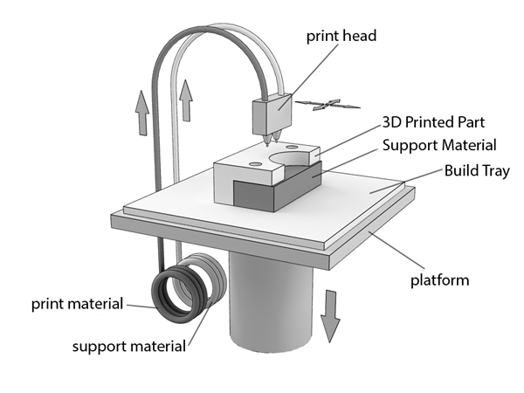
Process
SLA - 3D printing technology used for creating models, prototypes, and production parts in a layer by layer fashion using photo polymerizations, a process by which light causes chains of molecules to link, forming polymers Those polymers then make up the body of a three-dimensional solid.
https://www.google.com/search?q=Stereolithography+(SLA)&source=lnms&tbm=isch&sa=X&ved=0ahUKEwi65_alrp7ZAhWJMI8KHdPPAmMQ_AUICigB&biw=1242&bih=557#imgrc=jv9gmOMdTplC4M:
FDM - 3D printing technology used for creating models, prototypes, and production parts in a layer by layer fashion using FDM Technology that build parts layer-by-layer from the bottom up by heating and extruding thermoplastic filaments.
https://www.google.com/search?q=SHS+printing&tbm=isch&tbs=rimg:CW6sE_1G48hbJIjhNpBO7RffmeecDqGL49KHYL2H9aKG8HoPDvnLPo4ebtXkBiHwjb4iPECuzOFuhLzXNlAYDu8mgBioSCU2kE7tF9-Z5EbiybwJOkyO6KhIJ5wOoYvj0odgRB0cgpt0aYPUqEgkvYf1oobwegxHZ3Caj8PwlmSoSCcO-cs-jh5u1EUUq8A0kmVXkKhIJeQGIfCNviI8RHewAmLpWeCIqEgkQK7M4W6EvNRF7feBO-vkazSoSCc2UBgO7yaAGEej-lCxm28c_1&tbo=u&sa=X&ved=2ahUKEwiNvP3St57ZAhUDPxQKHeYCAaYQ9C96BAgAEB4&biw=1242&bih=557&dpr=1.1#imgdii=PQsPDzRBdVlyHM:&imgrc=z5G8G1Cp-YbbpM:

Slide 3
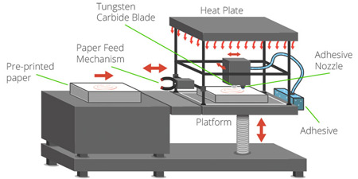
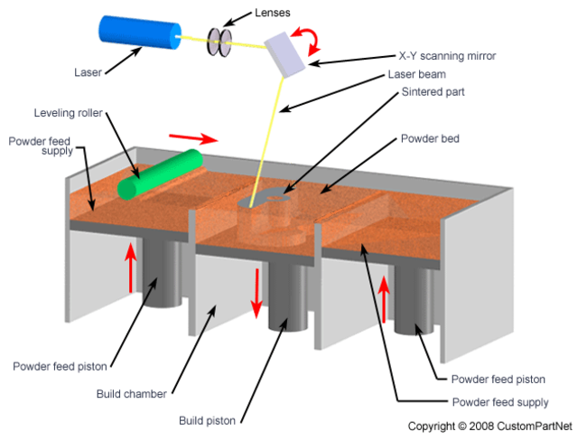
SHS - 3D printing technology that uses a thermal print head to apply heat to layers of powdered thermoplastic .When a layer is finished, the powder bed moves down, and an automated roller adds a new layer of material which is sintered to form the next cross-section of the model. SHS is best for manufacturing inexpensive prototypes for concept evaluation, fit/form and functional testing.
https://www.google.com/search?hl=en-KE&biw=1242&bih=557&tbm=isch&sa=1&ei=PoWAWpLkD8avUa_Ag4AL&q=shs+3d+printing+technology&oq=shs+3d+printing+technology&gs_l=psy-ab.3...208364.208770.0.209684.3.3.0.0.0.0.606.606.5-1.1.0....0...1c.1.64.psy-ab..2.0.0....0.q7ScxnkZgL8#imgrc=fjk4jkDCr8qovM:
SLS - 3D printing technology echnique that uses a laser as the power source to sinter powdered material (typically nylon) aiming the laser automatically at points in space defined by a 3D model binding the material together to create a solid structure.
https://www.google.com/search?q=SLS+printing&tbm=isch&tbo=u&source=univ&sa=X&ved=0ahUKEwjC85Oetp7ZAhUJ71MKHVEOAFUQsAQIOw&biw=1242&bih=557#imgrc=6Uz1rAE5k0CPmM:

Slide 4
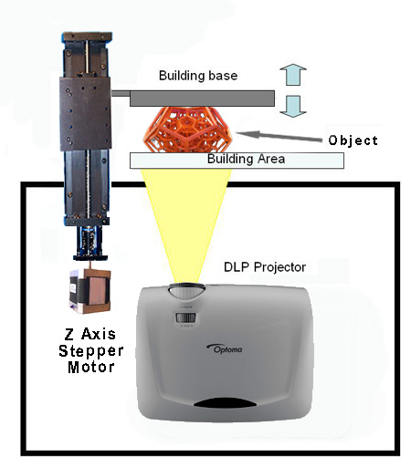
DLP - 3D printing additive manufacturing process where objects are created by a 3D printer that uses a digital light projector (DLP) as the light source for curing photo-reactive polymers. There are advantages and disadvantage
s to a DLP 3D printer over other types of printing methods such as SLA.
https://www.google.com/search?q=SHS+printing&tbm=isch&tbs=rimg:CW6sE_1G48hbJIjhNpBO7RffmeecDqGL49KHYL2H9aKG8HoPDvnLPo4ebtXkBiHwjb4iPECuzOFuhLzXNlAYDu8mgBioSCU2kE7tF9-Z5EbiybwJOkyO6KhIJ5wOoYvj0odgRB0cgpt0aYPUqEgkvYf1oobwegxHZ3Caj8PwlmSoSCcO-cs-jh5u1EUUq8A0kmVXkKhIJeQGIfCNviI8RHewAmLpWeCIqEgkQK7M4W6EvNRF7feBO-vkazSoSCc2UBgO7yaAGEej-lCxm28c_1&tbo=u&sa=X&ved=2ahUKEwiNvP3St57ZAhUDPxQKHeYCAaYQ9C96BAgAEB4&biw=1242&bih=557&dpr=1.1#imgdii=PQsPDzRBdVlyHM:&imgrc=z5G8G1Cp-YbbpM:

Slide 5
Build Materials.
Stereo lithography -SLA uses many materials including plastic material such as Polypropylene, Acrylate polymers, Nylon
Fused Filament Fabrication - One of the key advantages of FDM printing is its use of real engineering plastics, like ABS, polycarbonate, nylon 6 and nylon 12.
Selective Heat sintering- SHS 3D printers are designed to be used with thermoplastic powder only.
Selective Laser Sintering – SLS 3Dprinters use reinforced plastic such as nylon 12 HST, nylon 12 GSL and nylon 11
Digital Light processing – DLP plastic material are only liquid photopolymers such as R5, R11 and AB FLex

Slide 6
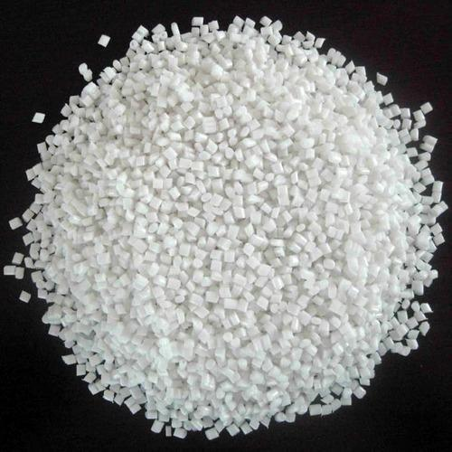

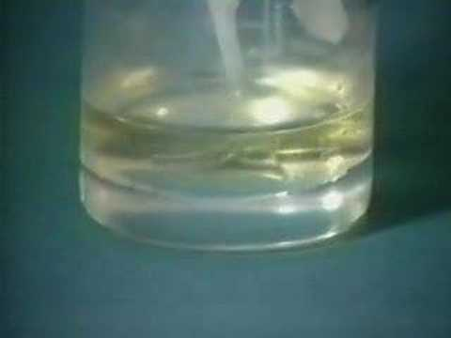
Raw Shape/Form.
Polypropylene; It is granular and sensitive to light. Melts to form a bath of about 0.1mm and additional layer is added.
Acrolyte polymers; It is liquid and sensitive to light. It forms a bath of about 0.1mm and additional layer is added.
Nylon; When loaded into machine is liquid and sensitive to light. It form aa bath of abou 0.1mm and additional layer is added. I comes in color options as white or black and different mixes of the two colors.

Slide 7
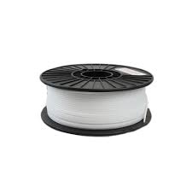
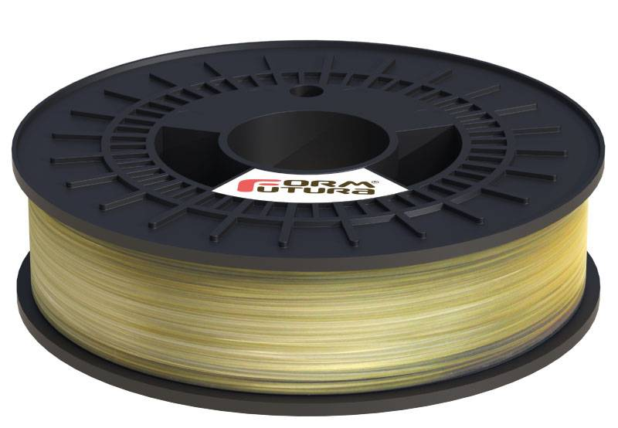
Raw Shape/Form
Polystyrene high impact; solid and sensitive to light. It is in form of a filament that is sensitive to light and is soluble.
Polyvinyl Alcohol; is solid and sensitive to light. It is in form of a filament that is sensitive to light and is soluble.

Slide 8
Work zone atamosphre
Stereolithography works in a normal atmospheric zone.
To prevent oxidation of metals due to the heat pf the laser beam shielding gases that are inert, such as argon and helium, are used.
In our case hover, shielding gases are not necessary because the material used is plastic.

Slide 9
Source of energy
Laser beams are used in Stereolithography to melt the metrix material.
low-power laser is used to harden photosensitive resin and achieve polymerization.
Spatial coherence focuses the laser on a tight spot form different sources of light.

Slide 10
Dimensional tolerance
First inch; +/- 0.005” or 0.127 mm
Second inch; +/- 0.007”
Third Inch; +/- 0.009”
Additional 0.002” for each additional inch.

Slide 11
Building speeds for each method
Technology | 3D Printer Model | Building Speeds
SLS | EOS P396 | Up to 48 mm/h
SLA | Projet 1200 | Up to 14 mm/h
DMLS | EOSINT 280 | 2 to 8 mm3/s
FDM |  | 50 to 150 mm/h

Slide 12
Building speed
Plastic | Maximum
 | 677 x 368 x 565 $/mm
Silver/Brass | Maximum
 | 60 x 80 x 100 $/mm
Resin | Maximum
 | 290 x 190 x 147 $/mm
Alumide | Maximum
 | 300 x 300 x 500 $/mm

Slide 13
Building costs
SLS | Maximum
 | 15 $/mm
SLA
 | 10 $/mm
FDM
 | 7 $/mm

Slide 14
DRAWBACKS
 | Fused Deposition Modeling (FDM) | Stereolithography (SLA) | Selective Laser Sintering (SLS)
Cons | Low accuracy Low details Limited design compatibility | Limited build volume on desktop | Rough surface finish Limited material options

Slide 15
References
Bártolo, P. J. (Ed.). (2011). Stereolithography: materials, processes and applications. Springer Science & Business Media.
Joe Lopes, A., MacDonald, E., & Wicker, R. B. (2012). Integrating stereolithography and direct print technologies for 3D structural electronics fabrication. Rapid Prototyping Journal, 18(2), 129-143.
Melchels, F. P., Feijen, J., & Grijpma, D. W. (2010). A review on stereolithography and its applications in biomedical engineering. Biomaterials, 31(24), 6121-6130.
Clay, K., Gardner, I., Bresler, E., Seal, M., & Speakman, S. (2002). Direct legend printing (DLP) on printed circuit boards using piezoelectric inkjet technology. Circuit World, 28(2), 24-31.
Silva, D. N., De Oliveira, M. G., Meurer, E., Meurer, M. I., da Silva, J. V. L., & Santa-Bárbara, A. (2008). Dimensional error in selective laser sintering and 3D-printing of models for craniomaxillary anatomy reconstruction. Journal of Cranio-Maxillo-Facial Surgery, 36(8), 443-449.
Skowyra, J., Pietrzak, K., & Alhnan, M. A. (2015). Fabrication of extended-release patient-tailored prednisolone tablets via fused deposition modelling (FDM) 3D printing. European Journal of Pharmaceutical Sciences, 68, 11-17.

